Slide 1

Travel and tour website
Higher National Diploma in Information Technology
Advanced Technological Institute
Tangalle
Final Year Individual Project
By: H.P.D.Dilshan Kumara
Register No: TAN/2023/IT/F/0062
Supervisor: Mr. G.R.C. Kumara

Slide 2
Introduction
The Travel and Tour Website simplifies travel planning by providing an online platform for exploring destinations, tour packages, and booking trips.
Users can book online, and administrators can manage data efficiently.

Slide 3
Background
Traditionally, travelers relied on travel agencies and brochures, which was slow and inconvenient.
With modern web technologies, this project offers a digital solution for easy, fast, and reliable travel planning.

Slide 4
Aim
To develop a web-based Travel and Tour Website where users can discover destinations, check tour packages, and make online bookings, while administrators manage tours and bookings securely.

Slide 5
Objectives
• Separate login portals for users and administrators
• Online booking system for tours and destinations
• Admin panel for managing bookings and destinations
• Secure authentication and role-based permissions
• Use of modern web technologies for a user-friendly experience

Slide 6
Problems
• Manual booking processes are time-consuming
• Errors due to manual data handling
• Limited access to travel information
• Difficult for admins to manage tours and bookings efficiently

Slide 7
Proposed Solution
A centralized web-based system that streamlines trip planning and booking.
Key Features:
• Centralized MySQL database
• Separate login portals
• Online booking and downloadable confirmations
• Admin dashboard with reports

Slide 8
Scope of the Project
• Secure login for users and admins
• Online browsing and booking of tours
• Admin capabilities to add, update, and delete records
• Reporting features for booking and customer management
• Secure data storage

Slide 9
Main Features
• Individual login accounts
• Admin panel for management
• Users can browse, book, and download receipts
• MySQL for structured data storage
• Reports and secure access
• Responsive and user-friendly design

Slide 10
Methodology
1. Requirements Gathering
2. Design Phase
3. Implementation (HTML, CSS, JS, PHP, MySQL)
4. Testing for functionality and security
5. Deployment using XAMPP
6. Maintenance and updates

Slide 11
Project Schedule/Plan
The development plan follows a structured SDLC:
• Requirement analysis – Week 1–2
• Design – Week 3–4
• Implementation – Week 5–10
• Testing – Week 11–12
• Deployment – Week 13
• Maintenance – Ongoing

Slide 12
Technologies Used
• Frontend: HTML, CSS, JavaScript
• Backend: PHP
• Database: MySQL
• Server: XAMPP
• Tools: Visual Studio Code, phpMyAdmin

Slide 13
Conclusion
The Travel and Tour Website simplifies the process of planning and booking tours, providing convenience for users and efficiency for administrators.
It delivers a reliable, scalable, and user-friendly platform for modern travel needs.

Slide 14
References
[1] | YouTube, " Travel Website Full Project (HTML, CSS, JS, PHP, MySQL)," [Online]. Available: https://www.youtube.com/watch?v=cgV2tN8gxCg&utm_source=chatgpt.com.
[2] | 2. YouTube, "Complete Travel Booking System Tutorial," [Online]. Available: https://www.youtube.com/playlist?list=PL7vVsrXwSezbaI_UOcdSBgvcAidxgKbUX&utm_source=chatgpt.com.
[3] | google, "FreeProjectz-Travel Website Source Code (HTML, CSS, JS)," [Online]. Available: https://www.freeprojectz.com/html-projects-mini-project/tour-and-travel-website-project-source-download?utm_source=chatgpt.com.
[4] | GitHub, " Simple Travel Booking Website (PHP, MySQL)," [Online]. Available: https://github.com/umaraziz0/Simple-Travel-Booking-Website?utm_source=chatgpt.com.
[5] | GitHub, "Responsive Travel Website Design (PHP, MySQL, JS)," [Online]. Available: https://github.com/HiruniPerera/Travel-website-Design?utm_source=chatgpt.com.

Slide 15

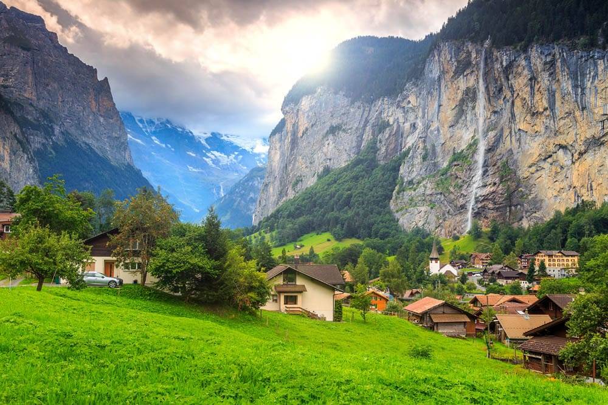
Thank you !

